Slide 1

SALES ORDER ANALYSIS REPORT
KOLAWOLE KANYINSOLA

Slide 2
OVERVIEW
This dashboard provides a detailed analysis of sales performance across years, sales reasons, salespeople, and countries. By tracking key metrics such as total sales, YoY growth, and average order value. it highlights performance patterns, sales reason effectiveness and regional contributions. The goal is to equip stakeholders with actionable insights that support strategic decision-making, improve sales efficiency and identify area for growth.

Slide 3
KPI.
Total sales
$140.71m
Order count
31k
AOV
4.47K
Avg days to ship
7
YOY
29.67%

Slide 4
Data Preprocessing
Cleaning of the dataset by handling null values
Calculation of Average Order value by dividing total sales by order count.
Calculation of average days to ship by using dated if to get the interval between order date & ship date.
Sales type breakdown : using if statement to categorize 0 or No salesperson to online and salesperson id to offline.

Slide 5
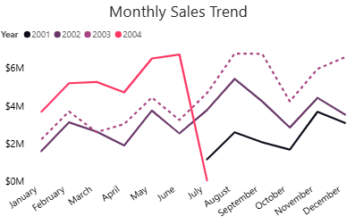
Monthly Sales Trend
Aug – sept are peak months in both 2002 & 2003.
Oct usually dips, but Nov- Dec performance varies( weak in 2002, stronger in 2003)
Jan- Apr shows unstable sales, moving up and down.
Overall, August – September drive the highest revenue making them the most consistent strong period.

Slide 6
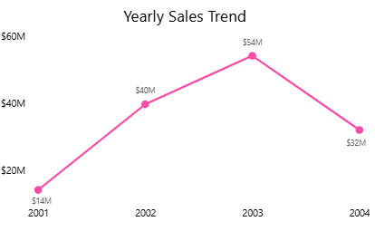
Yearly Sales Trend
Yearly Sales growth
2001: $14M , order - 1379 from July- dec.
2002: $40m, order – 3692 from Jan – dec.
2003: $54m, order – 12,433 from Jan – dec showing our peak year.
2004: $32m, order- 13,951 from Jan to July which suggests a higher growth rate by the end of the year

Slide 7
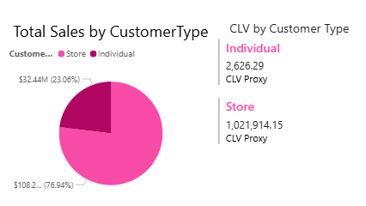
Total Sales by Customer Type
Stores contributed ₦108M(77%), making them the primary driver of overall sales.
individuals contributed ₦32M(23%), showing they play a much smaller role in total sales.
CLV: Store customers generate a high lifetime value than individual while Individual contributes smaller value but more frequent sales

Slide 8
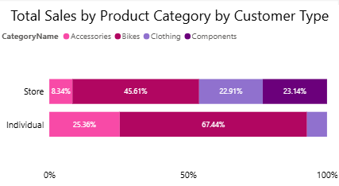
Total Sales by Customer Type & Products
Stores :
45% of total sales came from bikes, followed by components (23%) and clothing (22%).
Individual:
67% of total sales came from bikes, then Accessories (25%) but no sales for components.

Slide 9
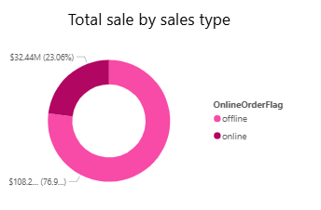
Total Sales by Sales Type
Offline sales made $108m from 3806 orders, while online sales made $32m from 27,659 orders showing offline made the highest revenue while online had the highest order rate.

Slide 10
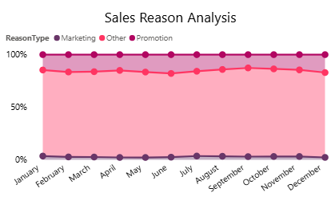
Sales Reason Analysis
Sales reason analysis
Other: This shows the highest category meaning people bought for different reasons.
Promotion: This had a slightly higher share than marketing.
Marketing: This shows the lowest share of orders.

Slide 11
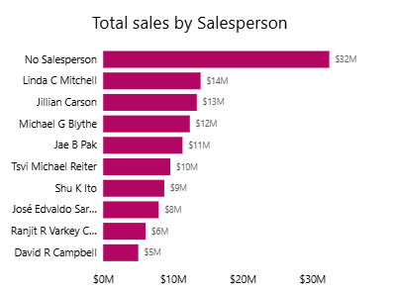
Total Sales by Salesperson
Most sales came from “No Salesperson,” suggesting many online purchases. The rest were split among key salespeople, with Linda driving highest offline sales of $14m and orders of 418 and Jillian had the highest orders of 473 and made sales of $13m.

Slide 12
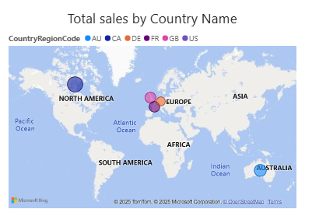
Total sales by Country
Canada made the highest revenue(₦21M) with 4,067 orders. Australia sold more items (6,843 orders) but made ₦12M. The UK and France each made about ₦9M, but the UK had more orders(3219). Germany had the lowest sales at ₦5M from 2,623 orders.

Slide 13
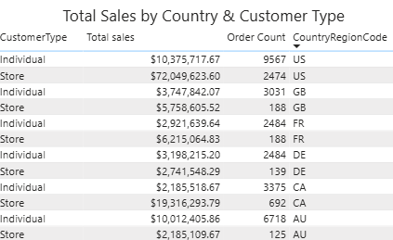
Total sales by Country & Customer Type
US made the highest sales:
Stores lead with $72M sales (2,474 orders) the highest revenue.
Individuals placed the highest orders (9,567) but a lower sales($10.3M). Canada is the next strongest market:
Stores: $19.3M from 692 orders.
Individuals: 3,375 orders but only $2.1M sales (lowest revenue per order across all markets).
Other countries (AU, FR, GB, DE) shows similar pattern of store(high revenue) and individual(high sales).

Slide 14
RECOMMENDATIONS.
Online channels generate higher orders but lower sales value, focus on upselling and bundling to boost purchase volume.
Improve data categorization for sales reason and focus more on marketing reason since it generated the lowest sales.
Individual customers have lower lifetime value compared to stores, build loyalty programs and offers to improve retention and purchase volume.
High performing regions like U.S should remain a priority but also invest in strategies to boost lower-performing regions such as Germany.
Prioritize marketing more in August and September to generate more sales.

Slide 15
CONCLUSION
Sales performance varies across regions, sales channels, and reasons for purchase. Offline sales bring in more revenue despite fewer orders, while online sales generate higher order volumes but lower total sales value. Certain regions like Canada and Australia lead in revenue and order counts, showing strong market demand.

